Slide 1
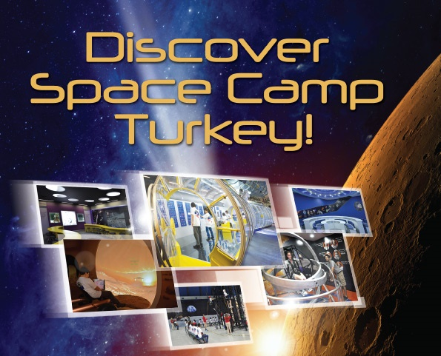
Notes:
As a space and science education center, Space Camp Turkey is primarily focused on motivating young people from around the world to pursue careers in science, math, and technology. All activities implemented in Space Camp Turkey are organized around STEAM+ Education standards. STEAM+ Education is an approach to learning that uses Science, Technology, Engineering, the Arts, Mathematics, Social, and Language as access points for guiding student inquiry, dialogue, and critical thinking. Through interactive, space-related simulations, both youth and adults learn about communication, teamwork, and leadership in a dynamic, fun-filled environment.

Slide 2
One of two Space Camps in the World!
Notes:
Education and entertainment center Space Camp Turkey, which was opened on June 12, 2000 has been visited by more than 260 thousand young people and adults from over 60 countries. Our state-of-the-art facility offers an ideal environment where young people from different nations can come together to build long-term friendships and understand other cultures.
Space Camp Turkey is the second Space Camp in the world. We are proud to have the only such facility in Turkey, the Middle East, Europe and Asia. It is located in the Aegean Free Zone, a high-tech industrial park in Izmir, operated by ESBAS. Izmir is a vibrant Aegean city on the western coast of Turkey with a population of over 4 million. 10 minutes from the International Airport 15 minutes from the City Center

Slide 3
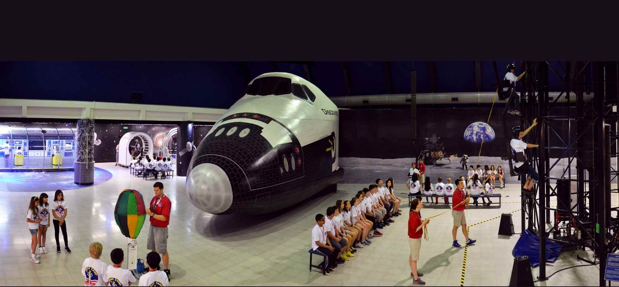
Space Camp Turkey Training Center
Notes:
Space Camp Turkey’s Training Center consists of 7 Astronaut Training simulators, a Computer Lab, 2 different Mission Control Rooms, Space Shuttle Discovery Mockup, A Space Station Module, Robotics Lab and several Classrooms.

Slide 4
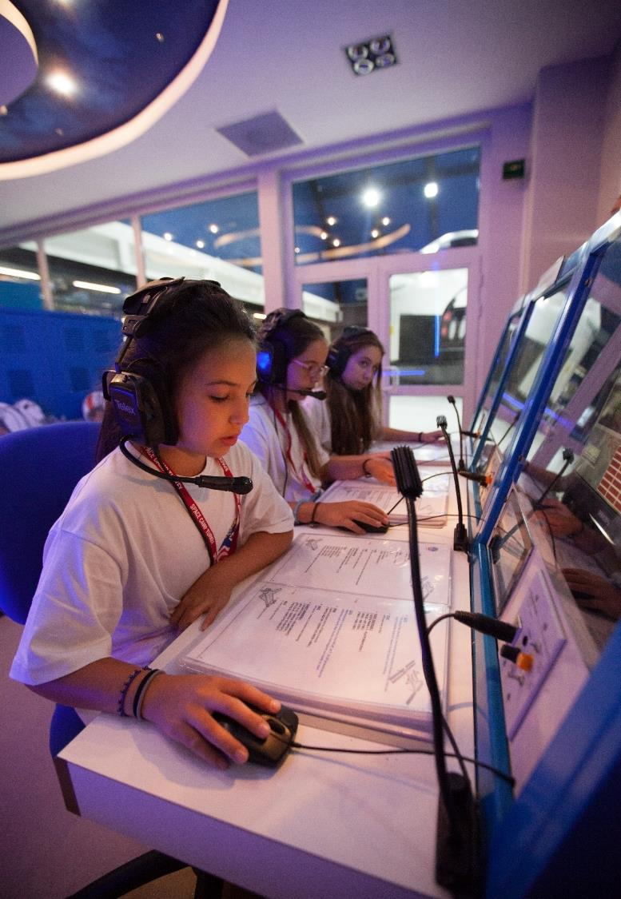
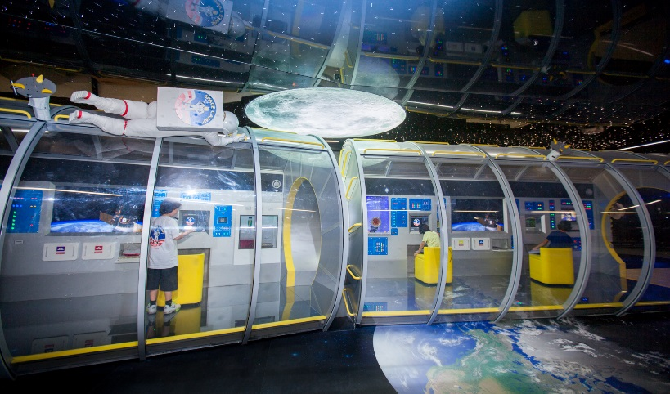
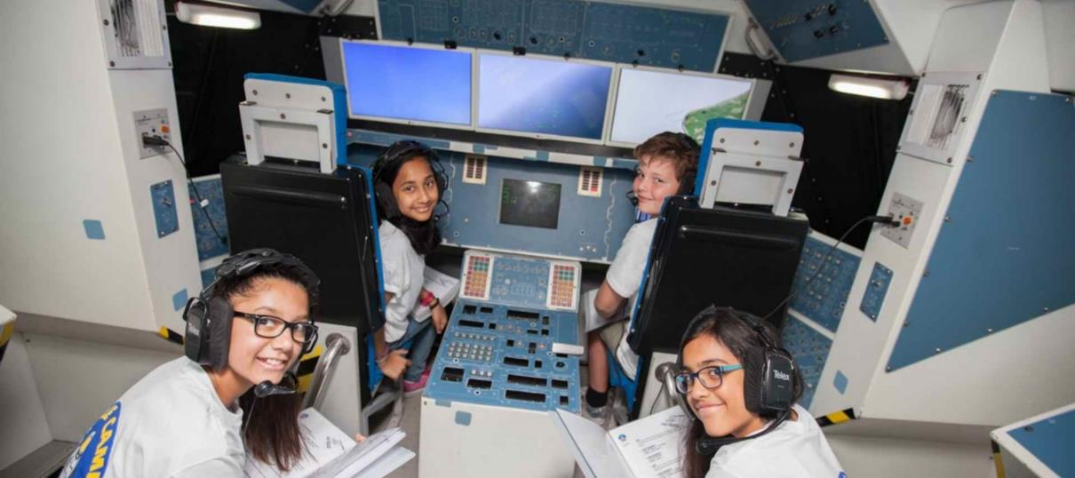
International Space Station
Mission Control
Space Shuttle
Notes:
The Mission:
Just like in real space shuttle missions, campers are invited to take responsibility, to develop leadership, problem-solving, and time management skills to share knowledge and learn how important it is to achieve success as a team.

Slide 5
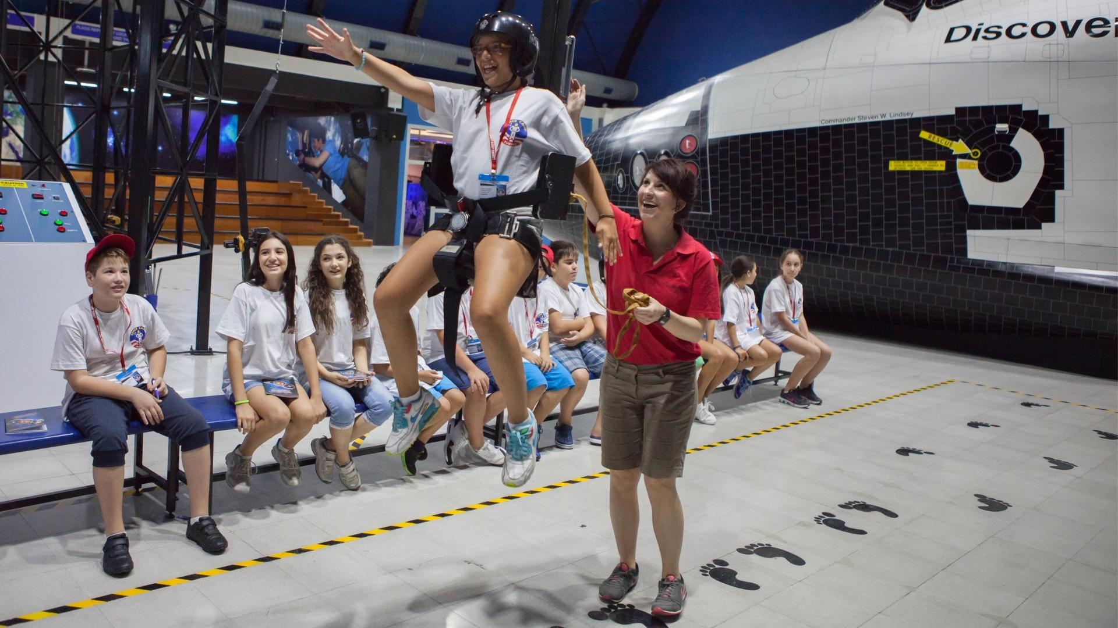
1/6th Gravity Chair
Notes:
The 1/6th Gravity Chair simulates the feeling of walking on the Moon. The Moon’s gravity is one-sixth that of Earth. This means that if you weigh 60 kg on Earth, you will feel like you weigh only 10 kg on the Moon.

Slide 6
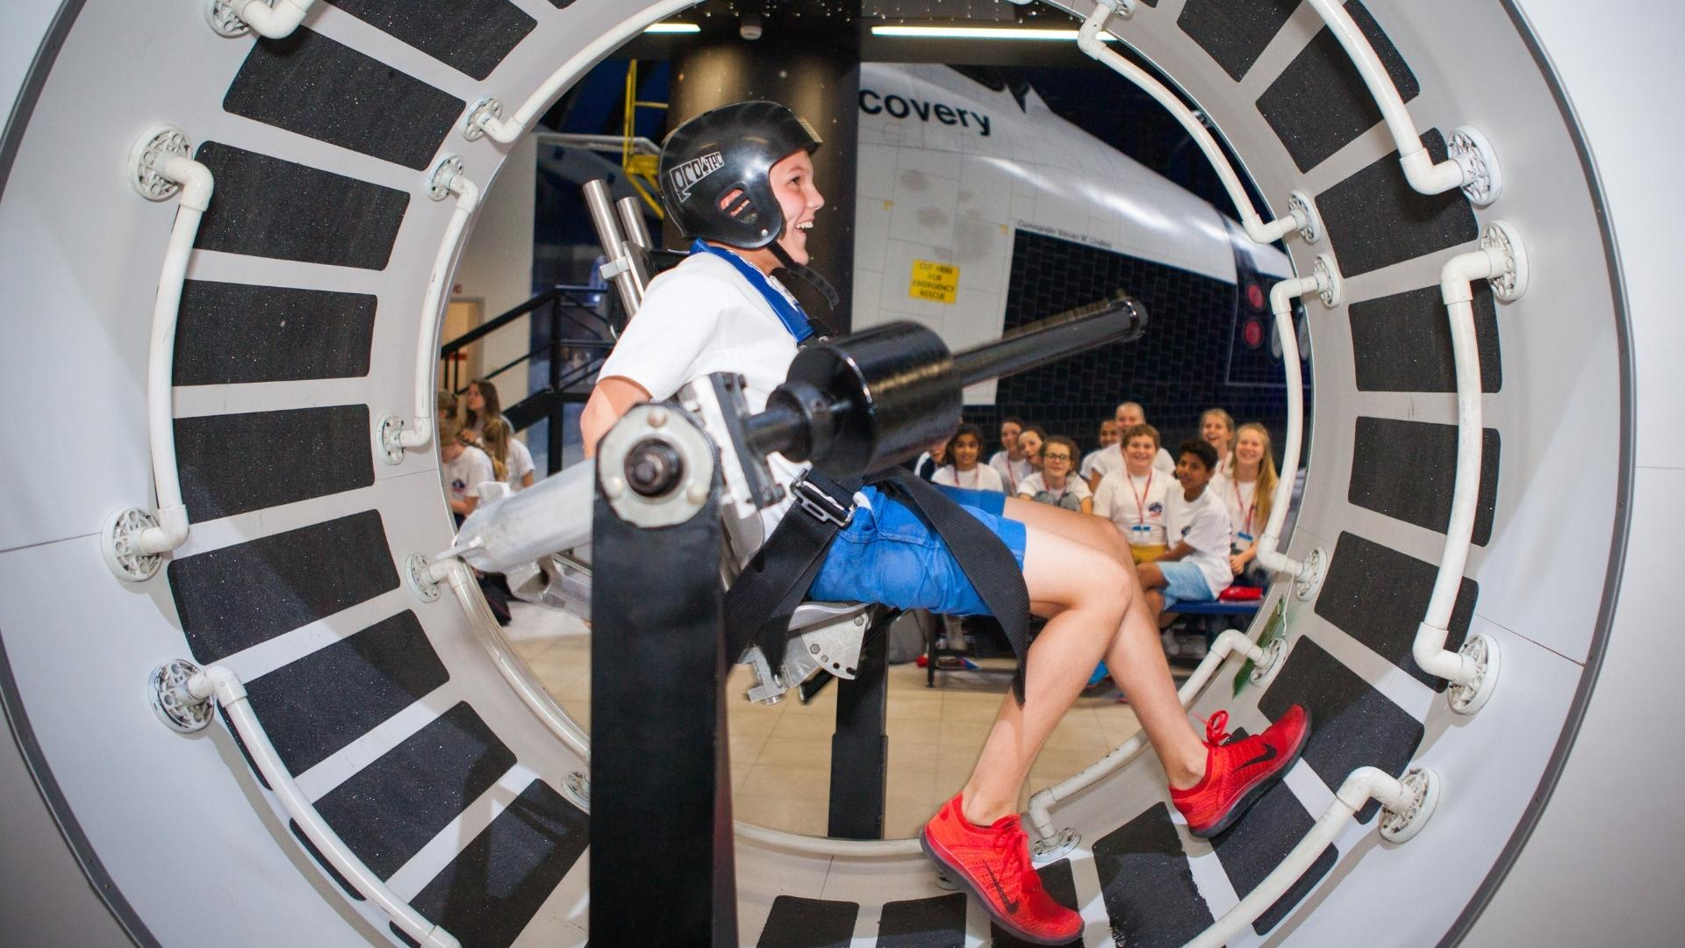
Space Station Mobility Trainer
Notes:
The Space Station Mobility Trainer (SSMT) simulates how astronauts on board Skylab exercised. One of the purposes of Skylab was to see how living and working in space for extended periods of time affected the human body. The astronauts learned exercise needed to be a vital part of their daily routines. In microgravity, it does not take much effort to move around or move large objects.

Slide 7
Zero-G Wall
Notes:
The Zero-Gravity Wall simulates what it is like to work in space. For example, building a space station while orbiting the Earth. When Skylab, America’s first space station, was launched, it was launched as in one piece. The International Space Station was built with individual pieces taken to space on many different missions. In order to get an idea of what to expect when they began building, the astronauts practiced on STS-61B mission.

Slide 8
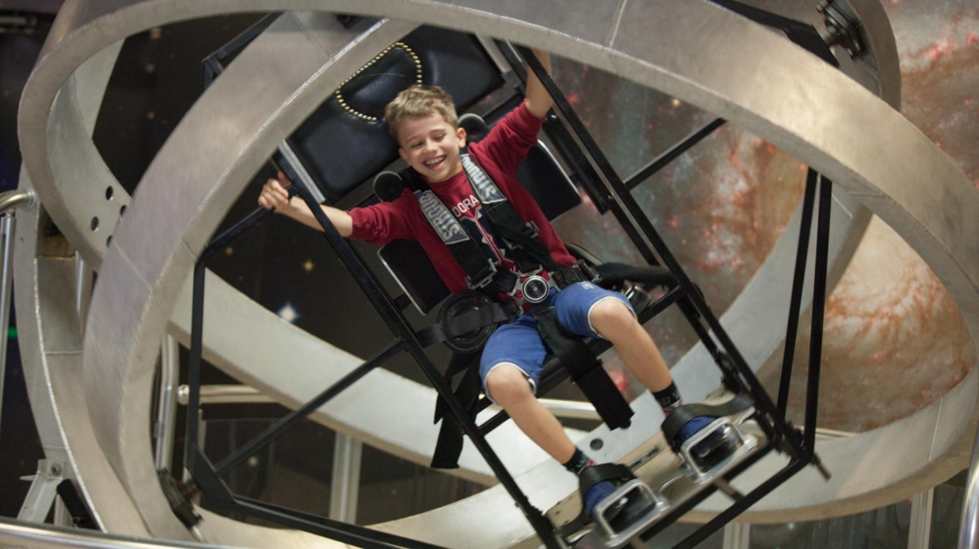
Multi-Axis Trainer
Notes:
The Multi-Axis Trainer (MAT) simulates a capsule going into a tumble spin.
The MAT is based on a simulator used during the Mercury Program known as the Multiple Axis Space Test Inertia Facility (MASTIF).
Although a Mercury capsule never experienced a tumble spin, a Gemini capsule did.

Slide 9
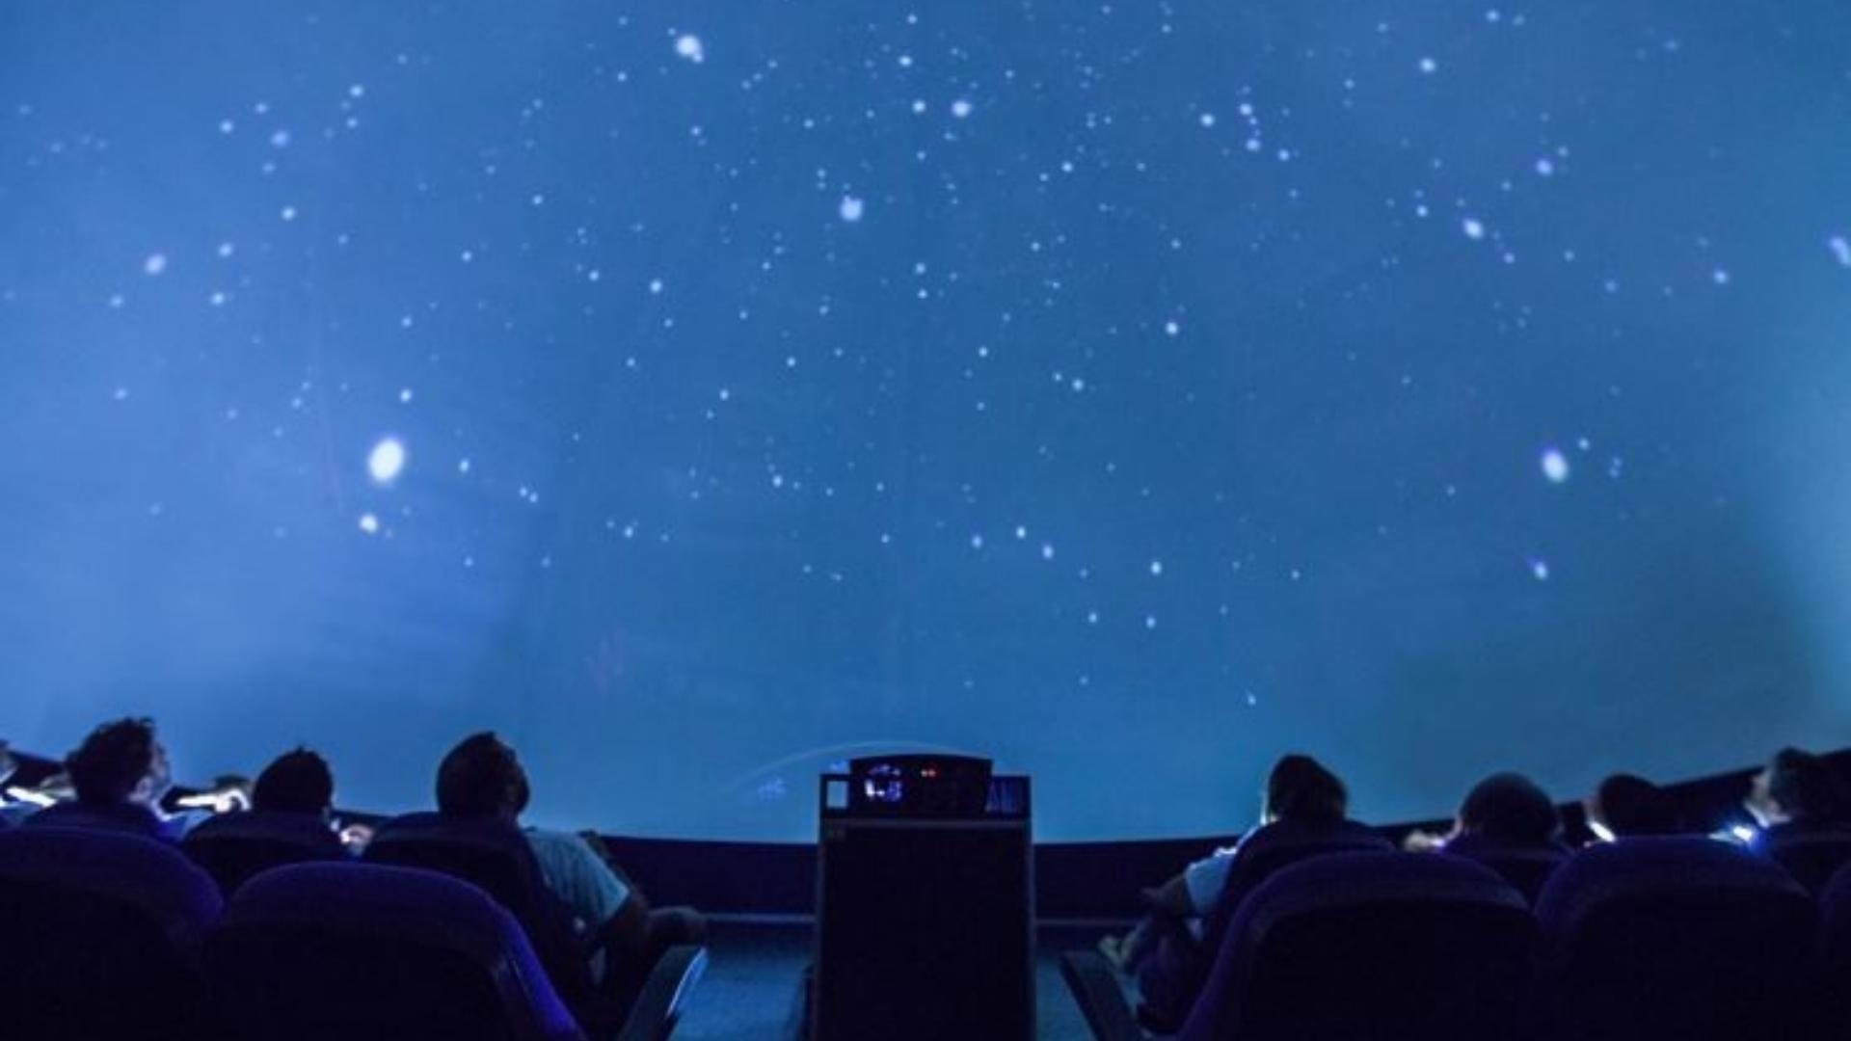
Planetarium
Notes:
Campers are taught about stars and constellations during this activity. The planetarium allows us to observe the night sky, stars, and constellations whenever and wherever we want in a predetermined time.

Slide 10
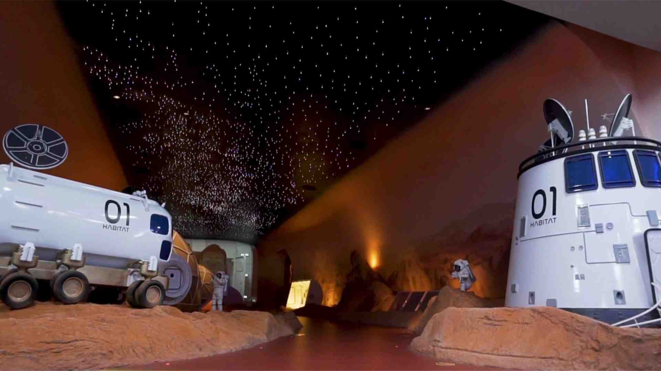
GENERATION MARS
Notes:
The Generation Mars Interactive Exhibit is designed to increase campers’ knowledge, awareness, and curiosity about the process of the scientific exploration of Mars.
For this activity, campers will be presented with information about the colonization of Mars, conditions on the Red Planet, and what resources are needed for humans to survive.

Slide 11
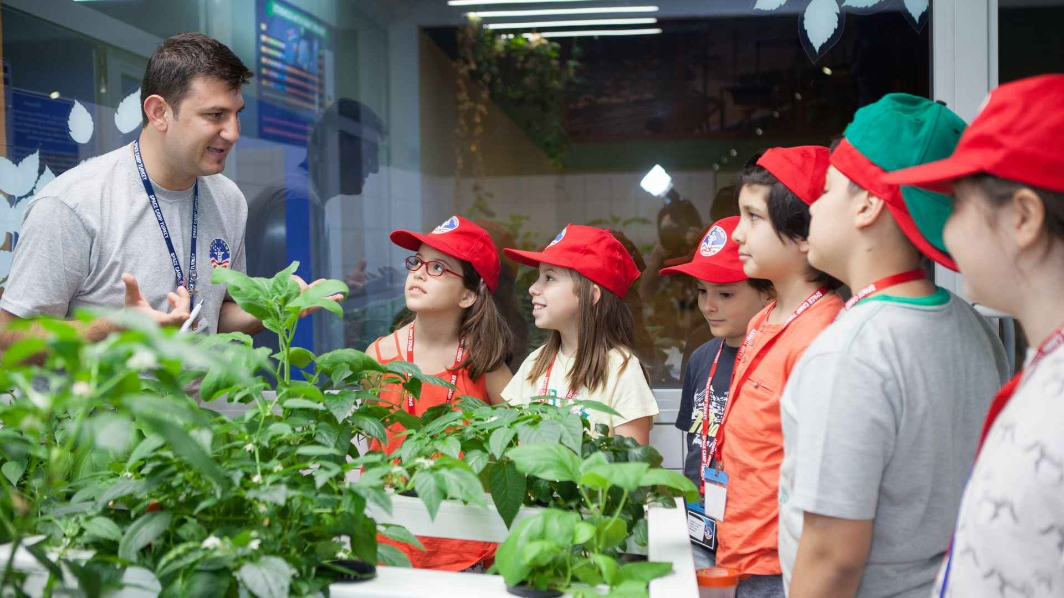
Hydroponics
Notes:
During this activity campers are informed about how to grow plants without soil and the need for hydroponics. Also, questions like «What do plants need to grow?» and «What kind of vitamins and minerals do plants need?» are answered.

Slide 12
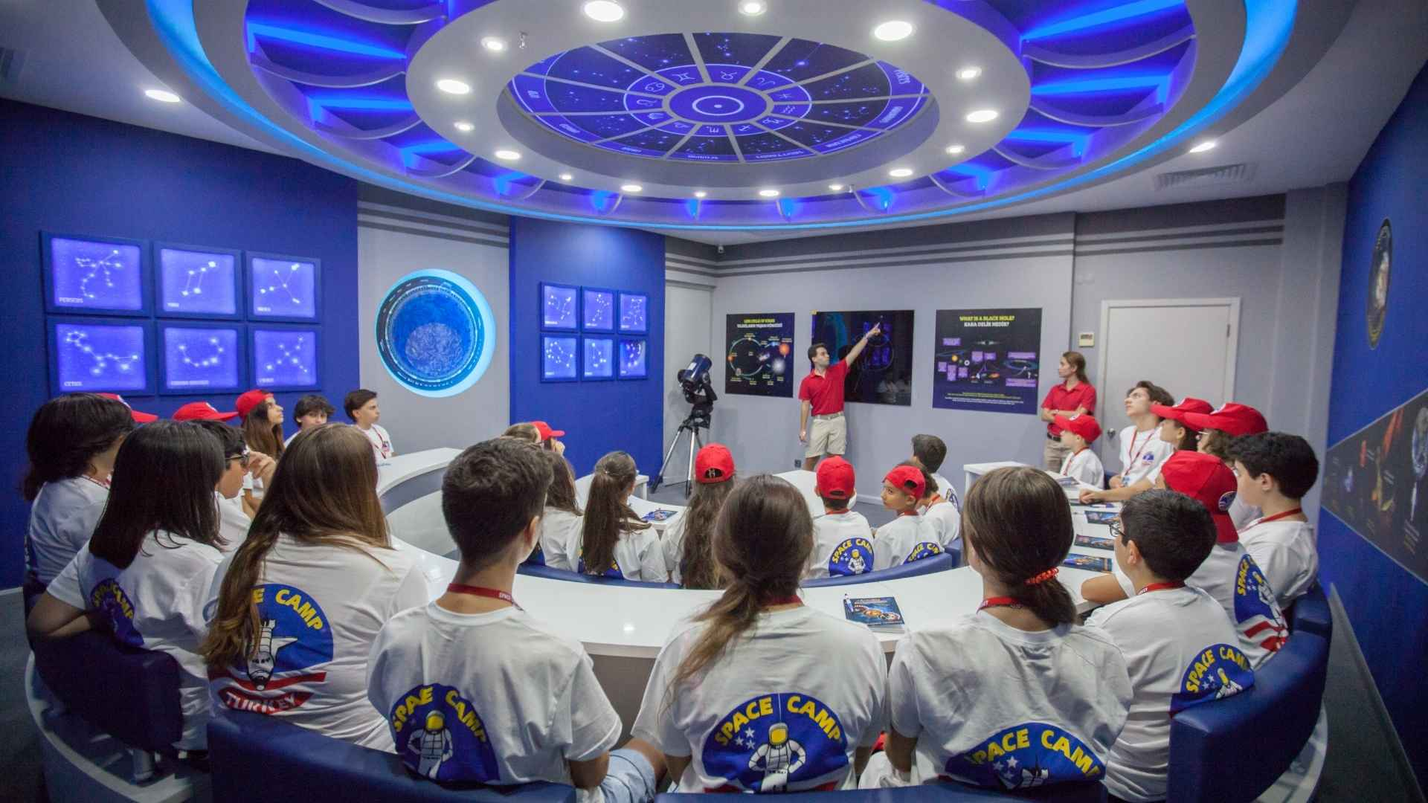
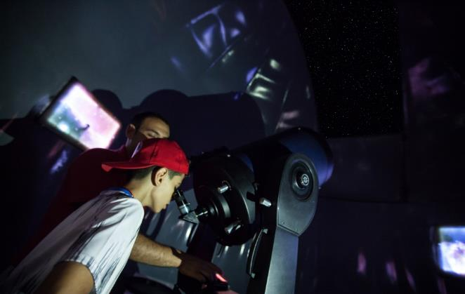
Astronomy at Galileo Classroom
Notes:
During the astronomy class at the Galileo classroom, the campers learn about the timeline of astronomical developments from the beginning of the astronomy history up to this day. They also learn about general astronomy terms and how to use a star map.

Slide 13
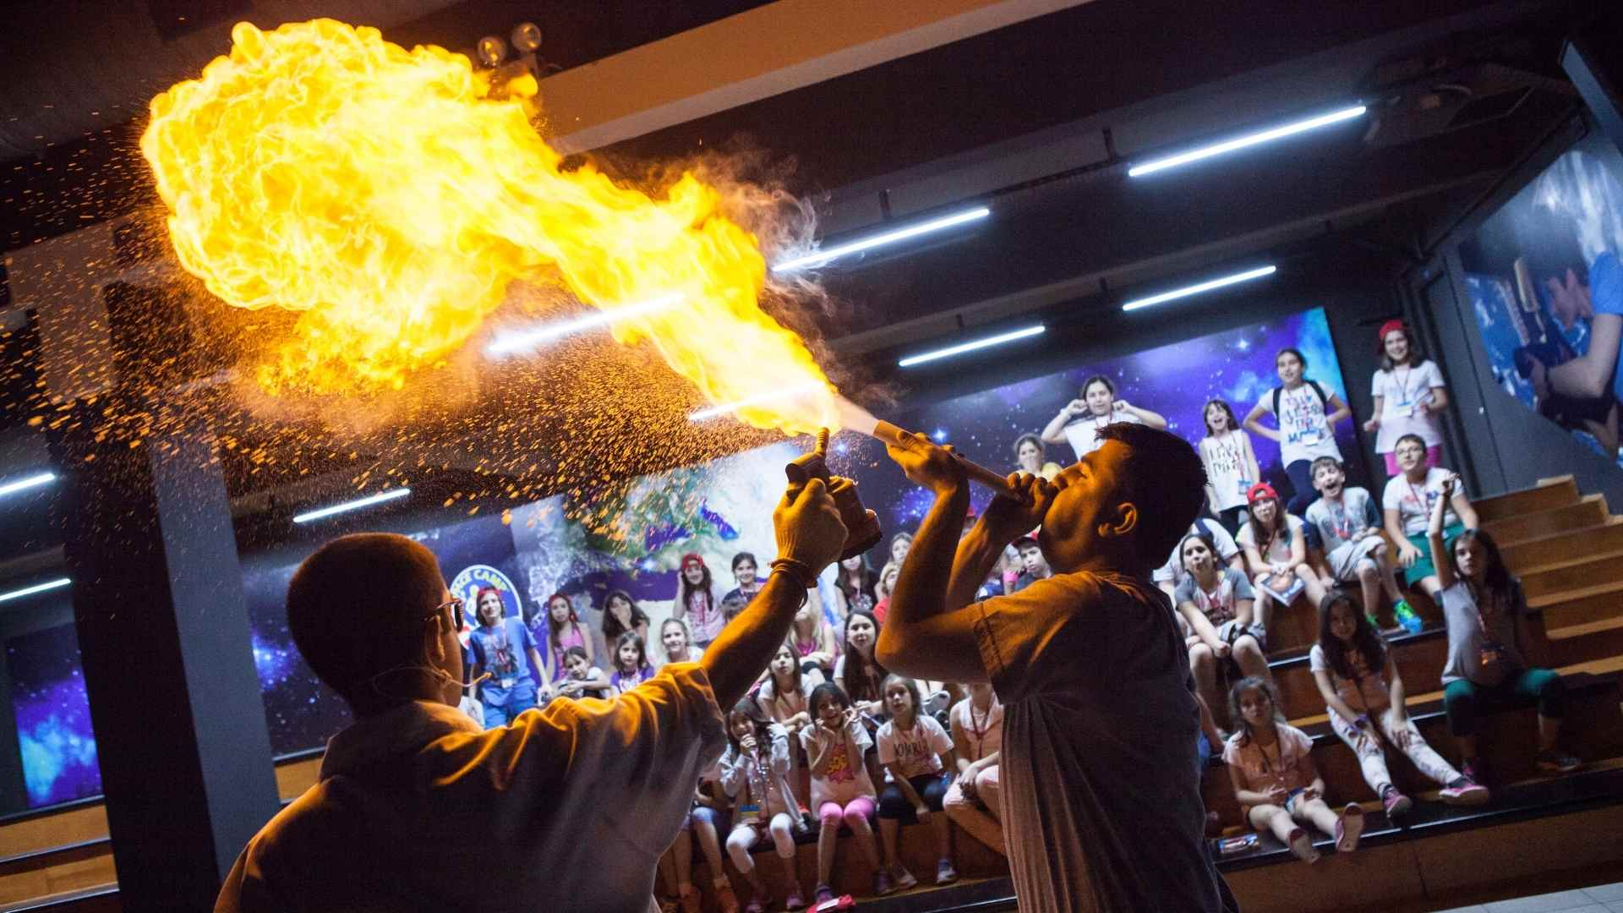
“Strange Science” Activity
Notes:
The Strange Science Activity is a fun way for campers to learn some of the fundamentals of science with interesting experiments. 5 different experiments take place.

Slide 14
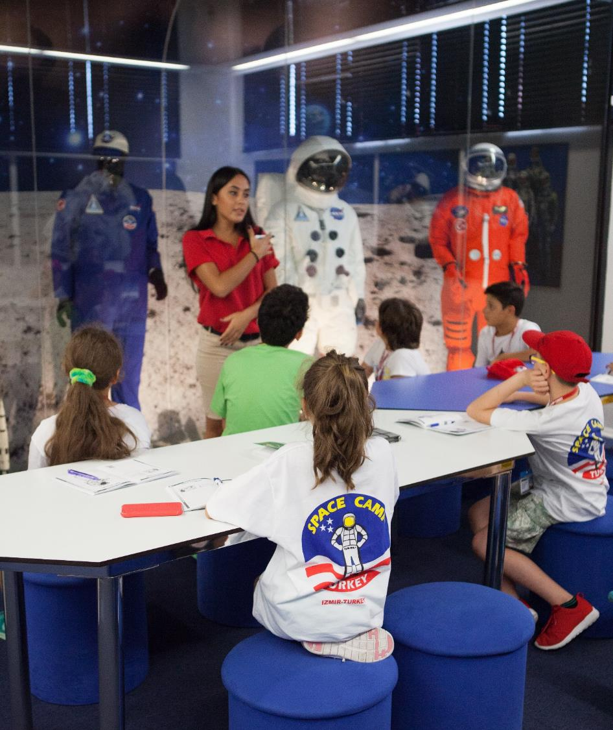
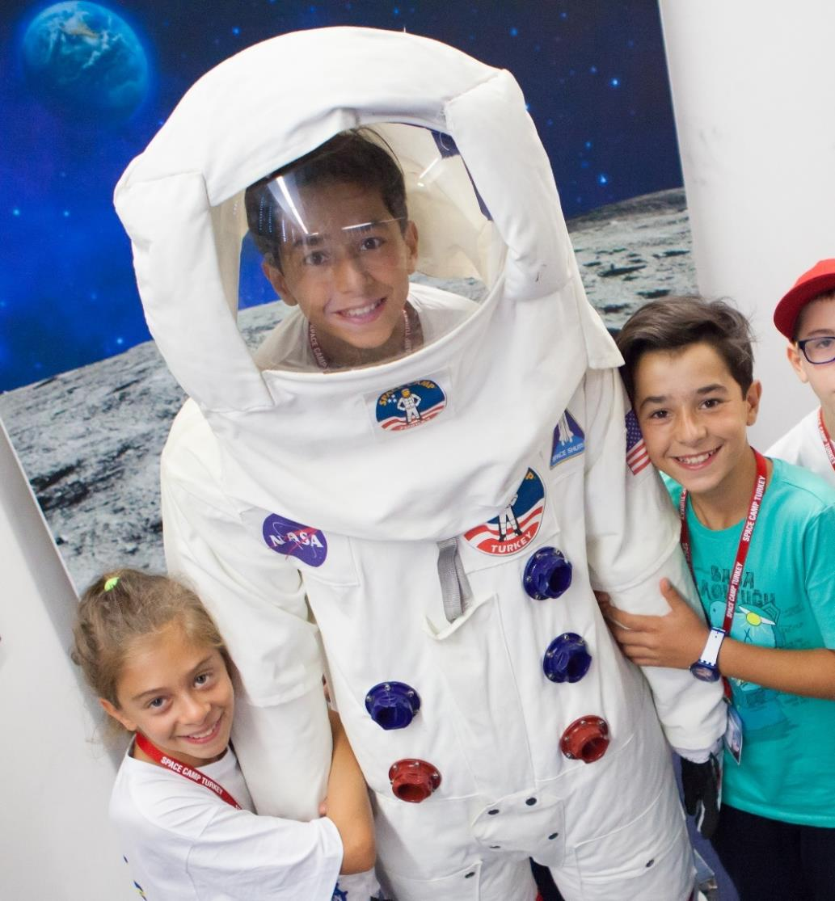
Space Suits
Notes:
The campers learn about the functions of a space suit and why it is important for astronauts to wear them in space.

Slide 15
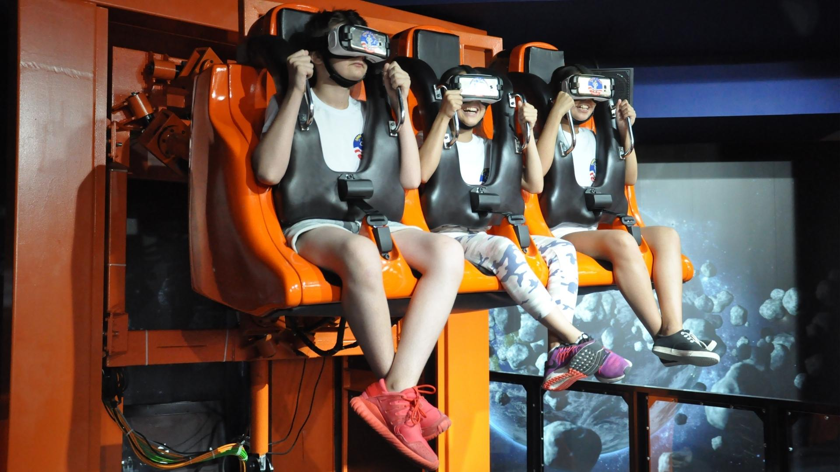
Hurricane 360 VR Simulator
Notes:
The Hurricane 360 VR simulator, which provides 6 degrees of movement freedom and can turn 360 degrees around its axis, experiences a thrilling virtual reality adventure via exclusive virtual reality glasses.

Slide 16
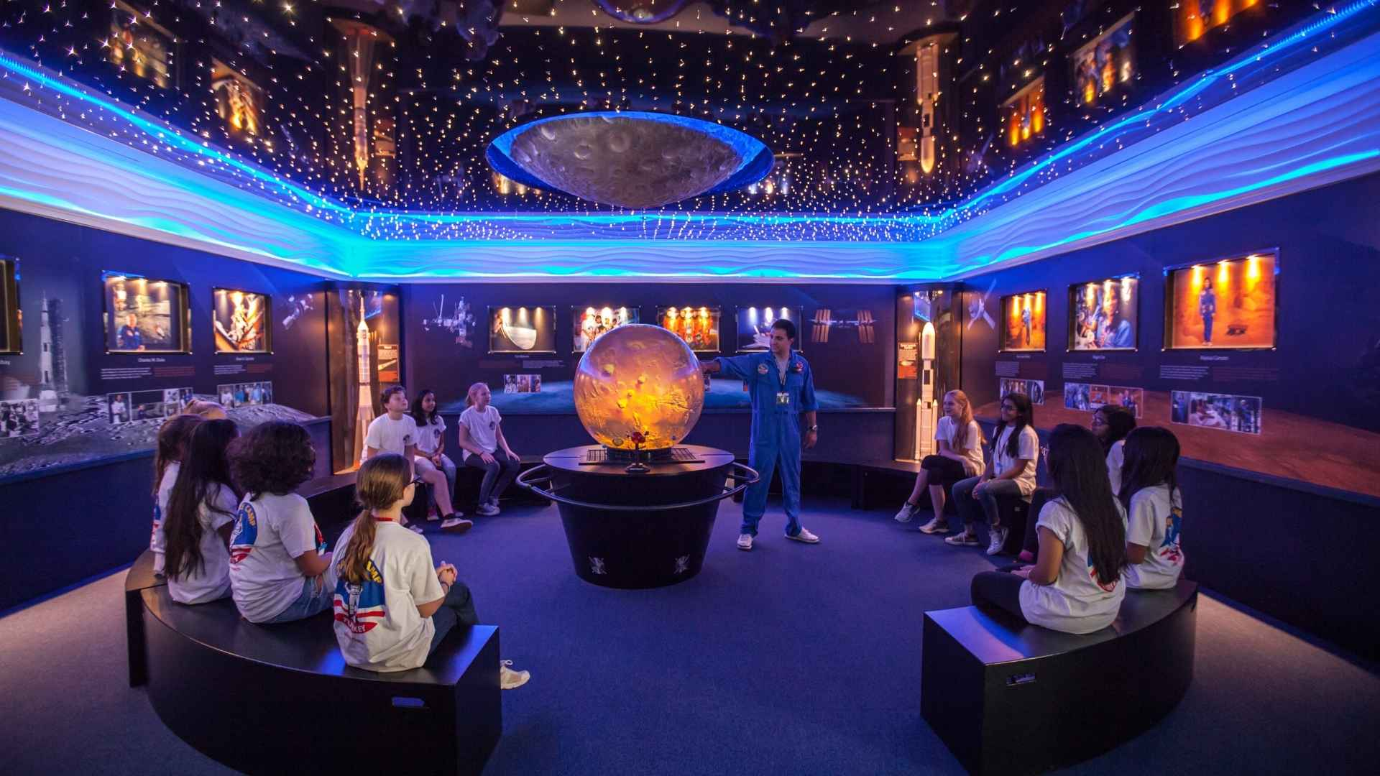
Magic Planet
Notes:
Campers are informed about the Solar System using the Magic Planet System. Each space object is reflected on the orb in the middle of the room.

Slide 17
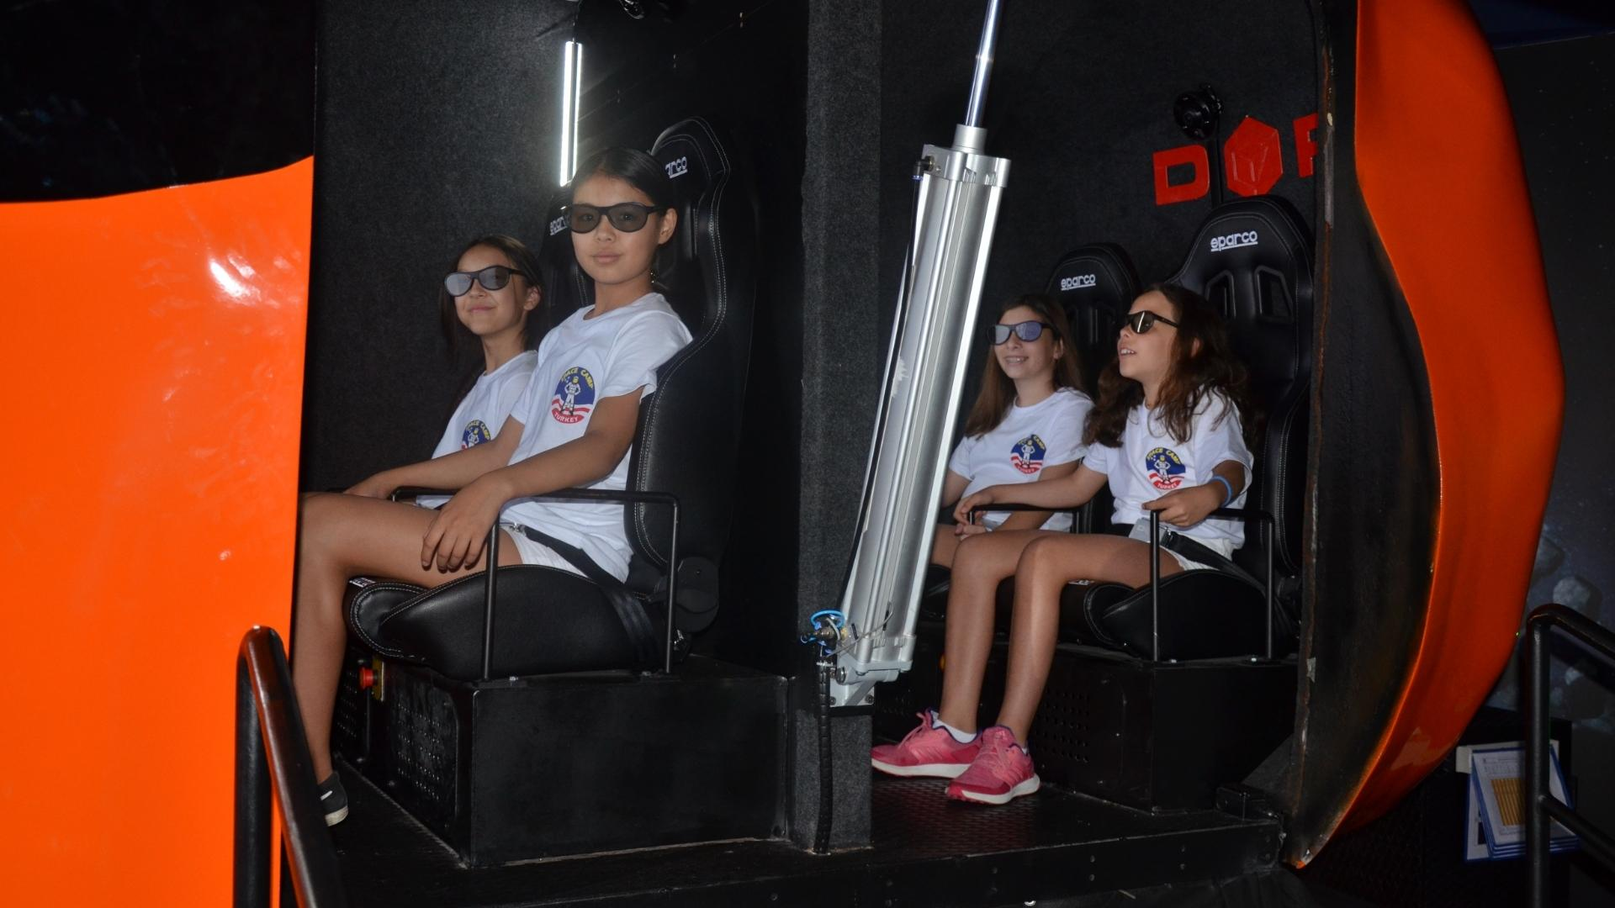
RIOT 3D Ride Simulator
Notes:
This 3D adventure simulator uses 3D glasses and high motion angles while the campers experience an adventure on the surface of the Moon.

Slide 18
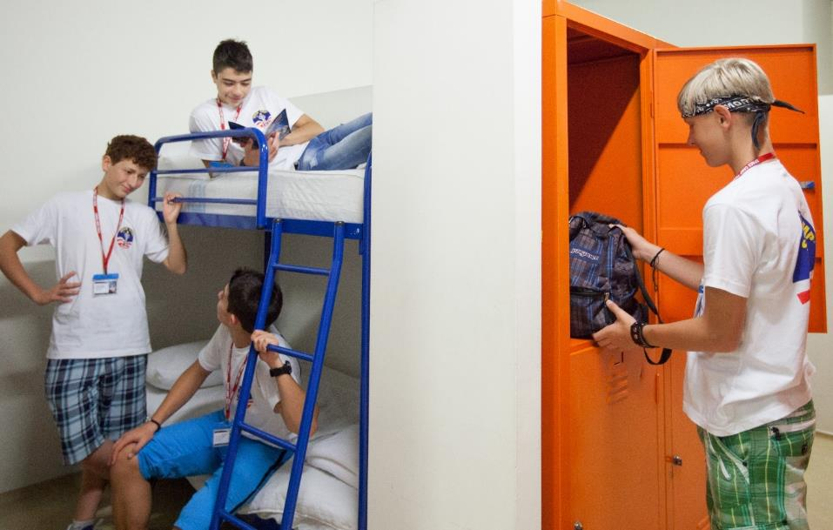
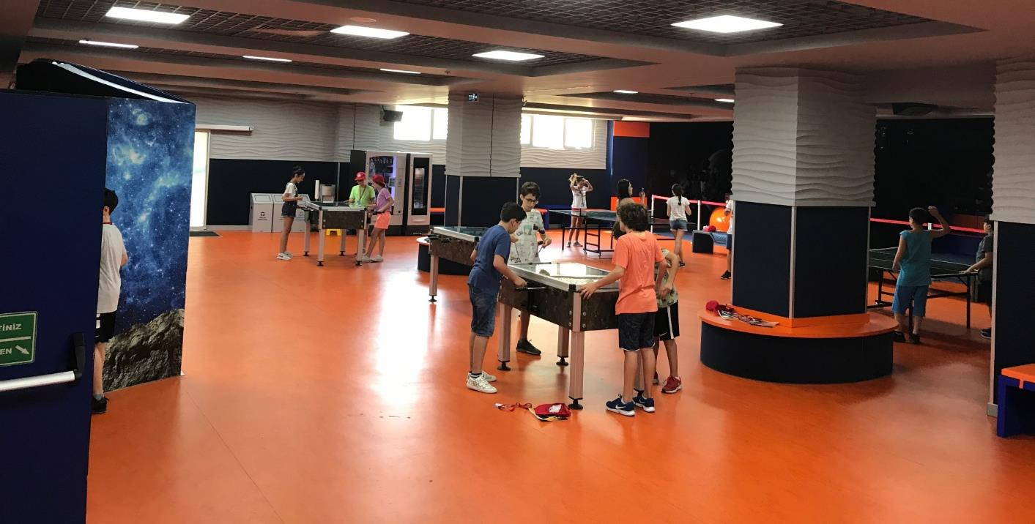
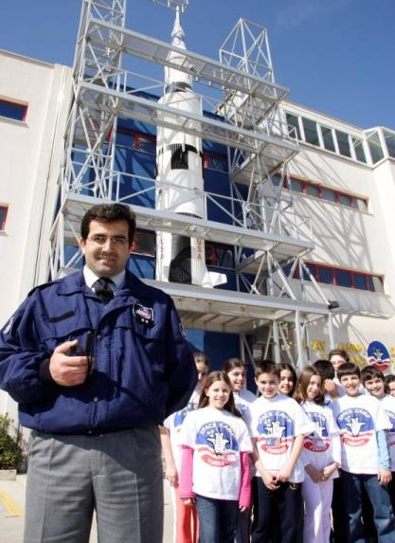
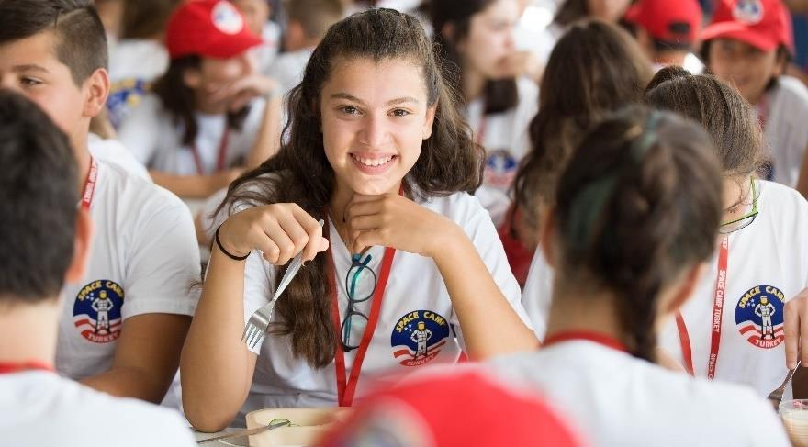
Space Camp Facility
Notes:
The campers will be staying in boys and girls dormitories which are on different floors. Each camper also has their own locker. The camp has its own infirmary and security guard. Students can have 3 meals a day at the Galaxy Cafe located on the third floor of the Space Camp building.

Slide 19
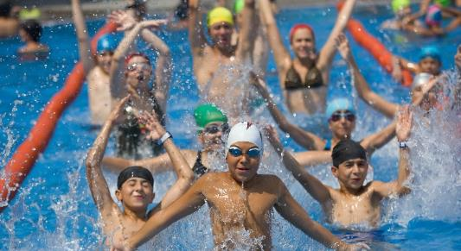
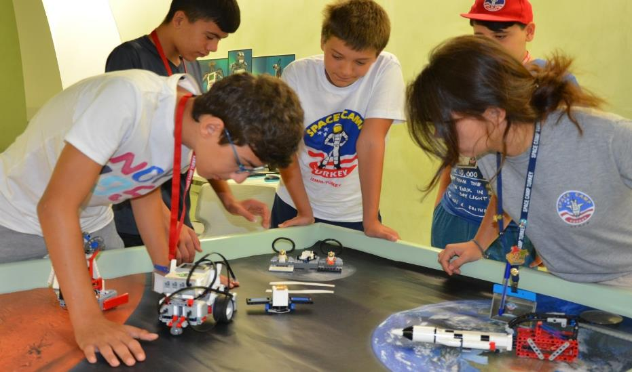
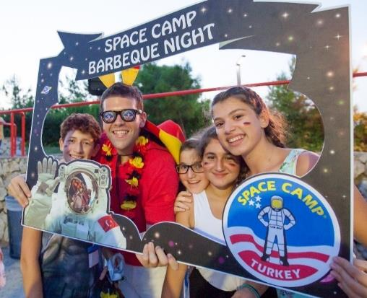
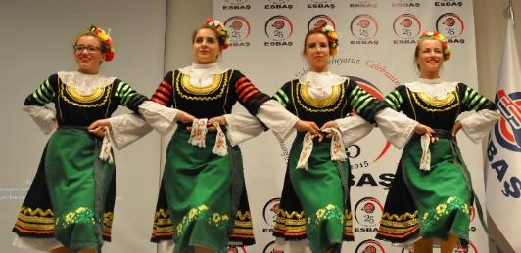
GALACTIC SUMMER CAMP
YOUTH CAMPS
(SUMMER)
Notes:
Galactic Summer Camps are international summer science camp programs specially created for students aged 9-15. Summer camps are held in six-day periods during June-August starting on a Sunday and ending on a Saturday. Summer camp programs offered in some weeks are differentiated with special themes. Unique training tools such as Generation Mars Interactive Exhibition Area, Discovery space shuttle and space station models are used in activities offered in a safe environment at international standards. With the interactive activities, an ideal environment is provided for team work, time management, problem solving and the development of self-confidence. They build international friendship through BBQ night activity, Special Events Night where the participants make presentations, dance, read poems and do many cultural things etc. There are options including “robotic” activities.

Slide 20
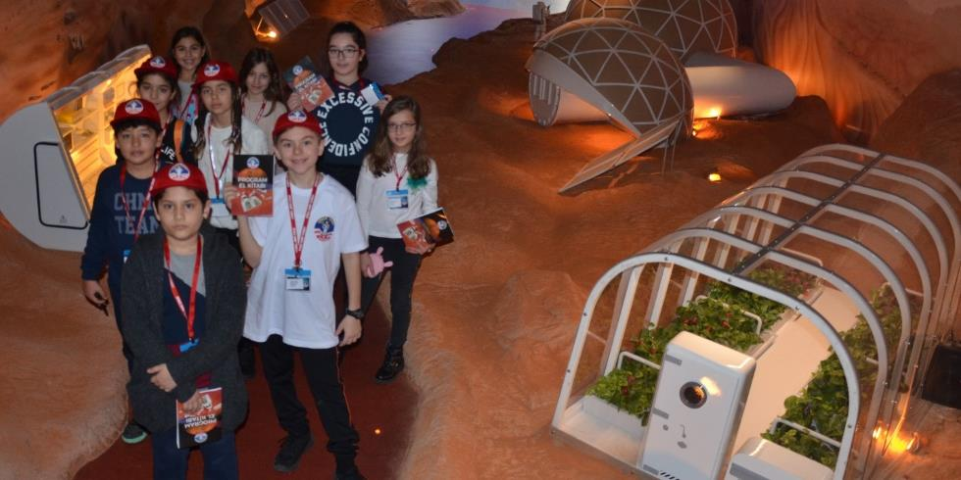
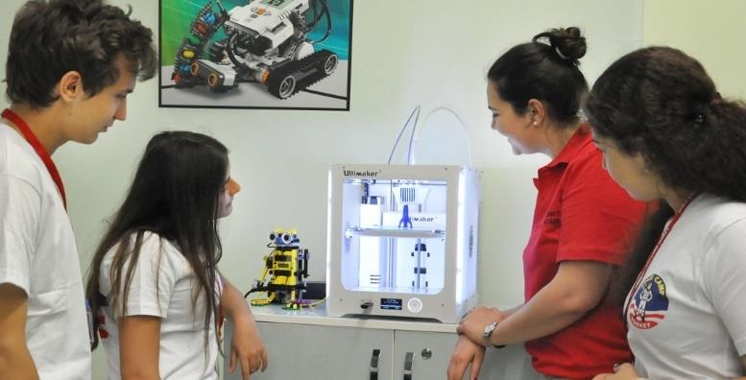
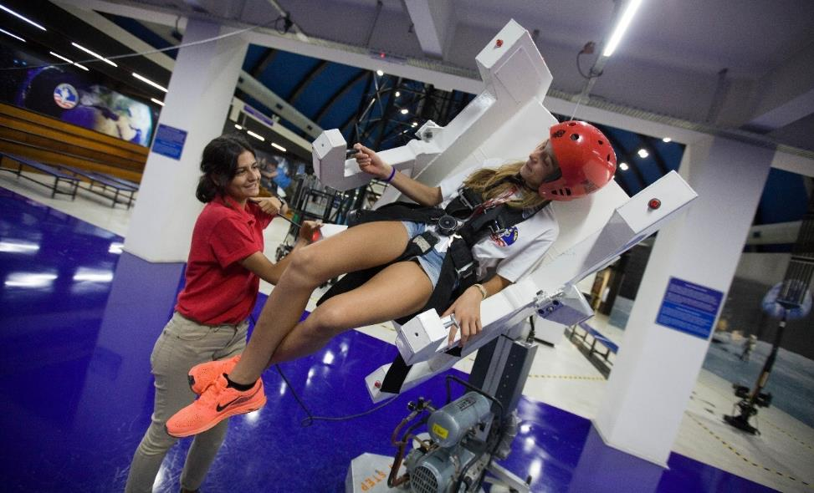
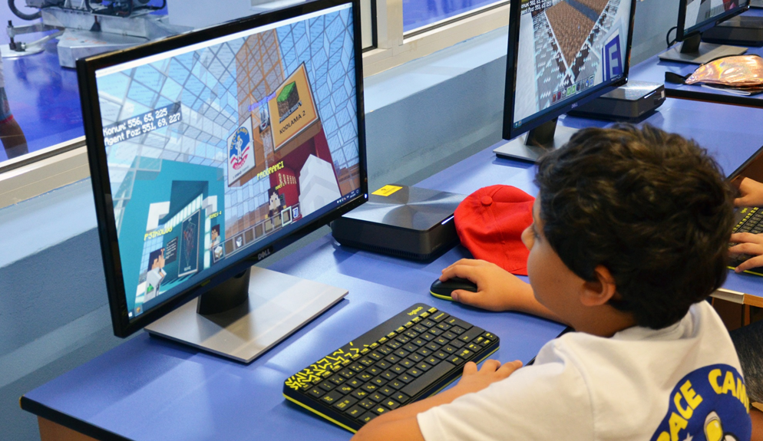
JOURNEY TO MARS
YOUTH CAMPS
ASTRO-ADVENTURE
(SUMMER / WINTER)
OUTER SPACE ADVENTURE
MINECRAFT NEW HORIZONS
Notes:
Space Camp offers the following programs for kids and teenagers; 3 nights accommodated Minecraft New Horizons program for kids aged 9-13 where the basic concepts of coding are taught using Code Builder’s web based learning environment MakeCode which is based on a drag-and-drop interface, 1 night accommodated Astro-Adventure program for teenagers aged 16-18 where they experience a virtual space flight mission and participate in coding workshops that include a 3D printer. 2 nights accommodated Outer Space Adventure program for kids aged 9-15 where they train in space sciences, establish teamwork through space simulations and understand space technology, and Journey to Mars program for kids aged 10-13 where they explore “new worlds” by designing a Mars Rover using the LittleBits™️ Mars Rover Kit, as well as look into the Future Mars Generation with 3D mapping projections and realistic habitat modules.

Slide 21
SPACE EXPLORERS
YOUTH CAMPS
(WINTER)
SPACE EXPLORERS WITH ROBOTICS
Notes:
5 nights accommodated Space Explorers program teaches team-building techniques and lets the participants explore space sciences through participating in a one hour simulated Space Shuttle mission, designing a Mars colony, conducting chemical experiments in our science laboratory, discovering the various history of NASA’s space suits through the different space programs, building a robot with the help of programming and engineering and participating in our Robotics Competition.

Slide 22
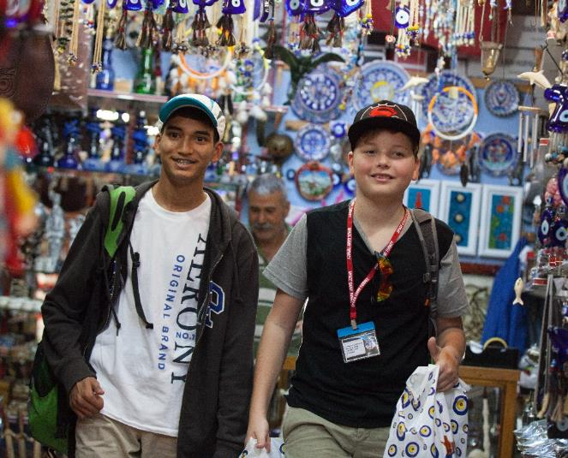
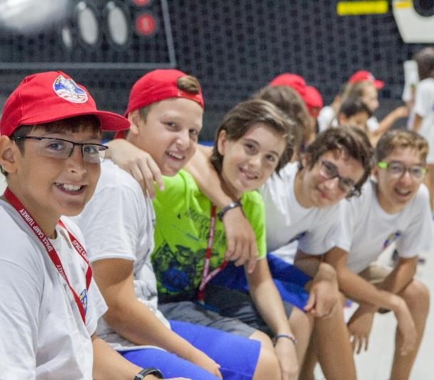
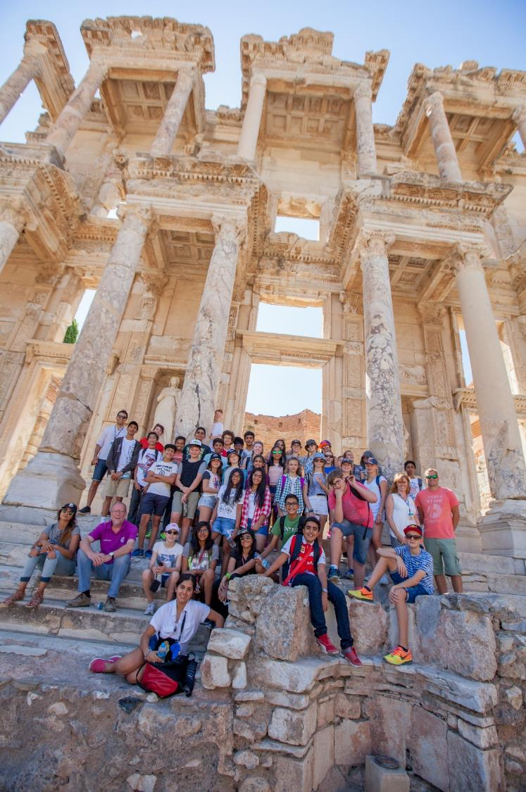
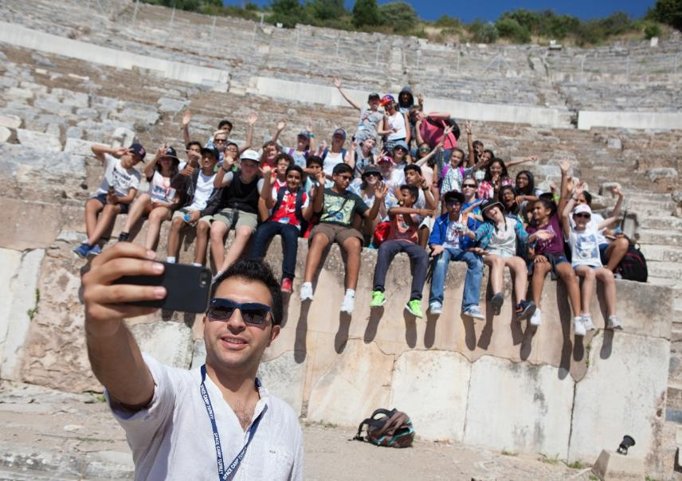
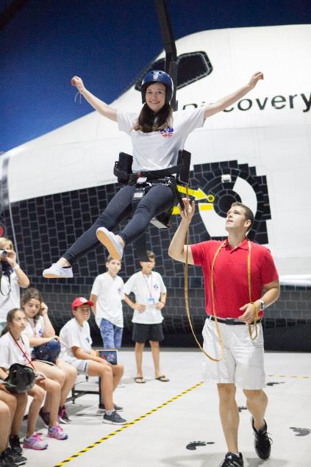
YOUTH CAMPS
SEPTEMBER - JUNE
Notes:
Customized camp programs for children and teens aged 9-18 are action-packed programs known as “Customized Outer Space Adventure”. Customized camp program length and activities can be tailored to better fit the needs of school groups and is available only during the school year and special holidays. The program is conducted only for group reservations. Customized programs for children and teens train youth in space sciences, promotes teamwork through space simulations, and provides a fundamental understanding of space technology.

Slide 23
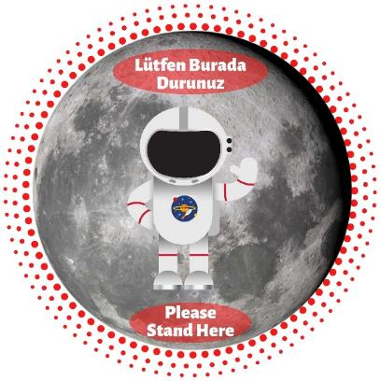
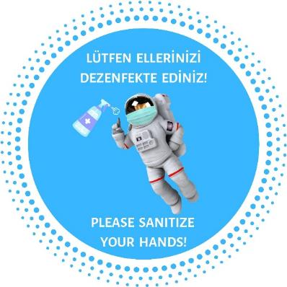
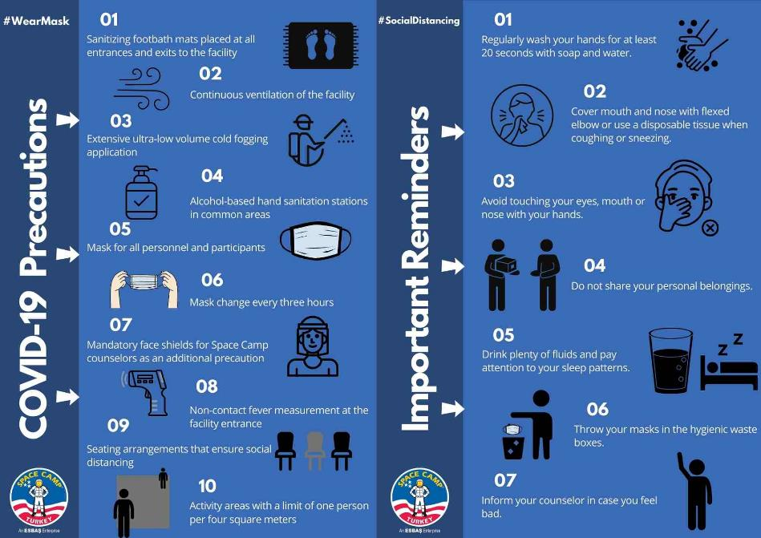
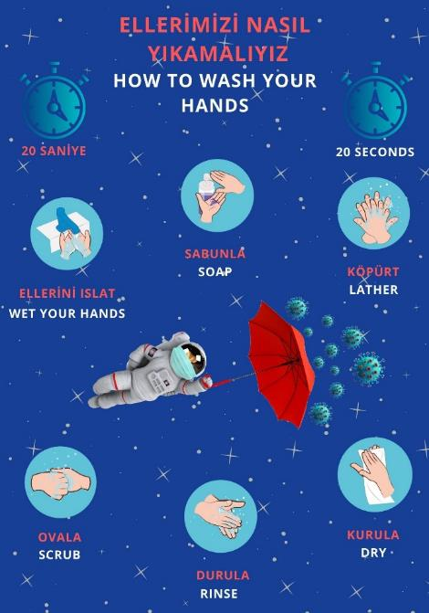
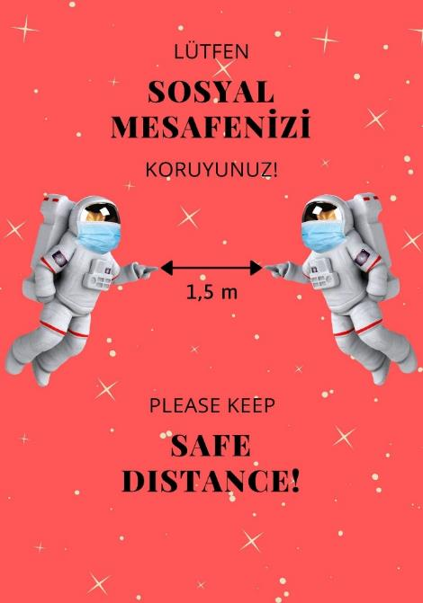
Covid-19 Precautions
Notes:
All necessary COVID-19 precautions have been taken by the Space Camp Staff.

Slide 24
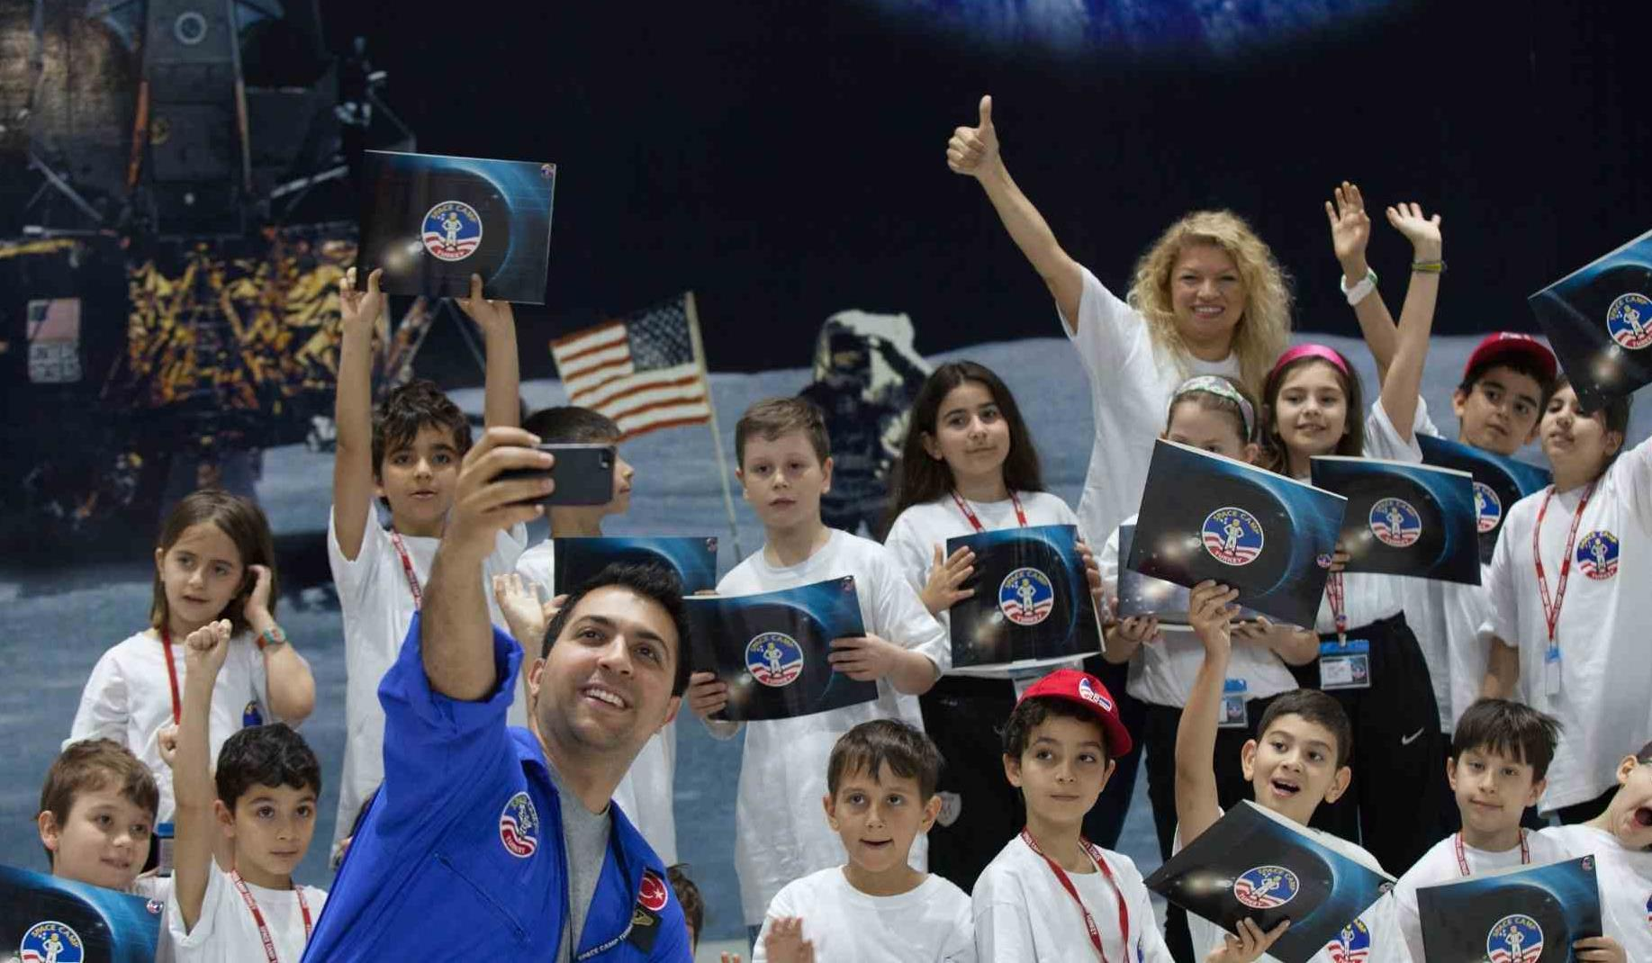
Notes:
At the end of each program, all campers receive a certificate.

Slide 25
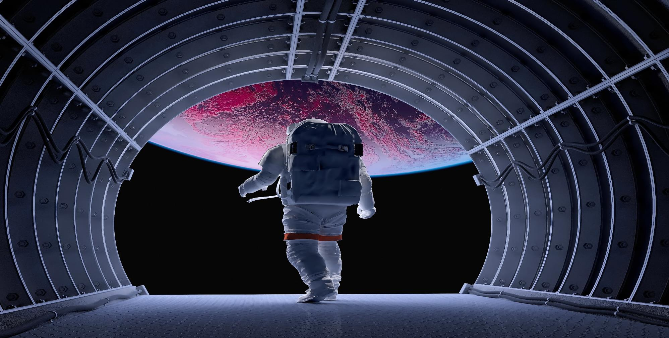
We Look Forward to Welcoming You at Space Camp Turkey!
www.spacecampturkey.com / info@spacecampturkey.com

